Slide 1


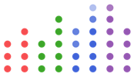



Parallel Computing’s Biggest Challenge
Alan Edelman
SIAM PP 2022
February 23, 2022

Slide 2
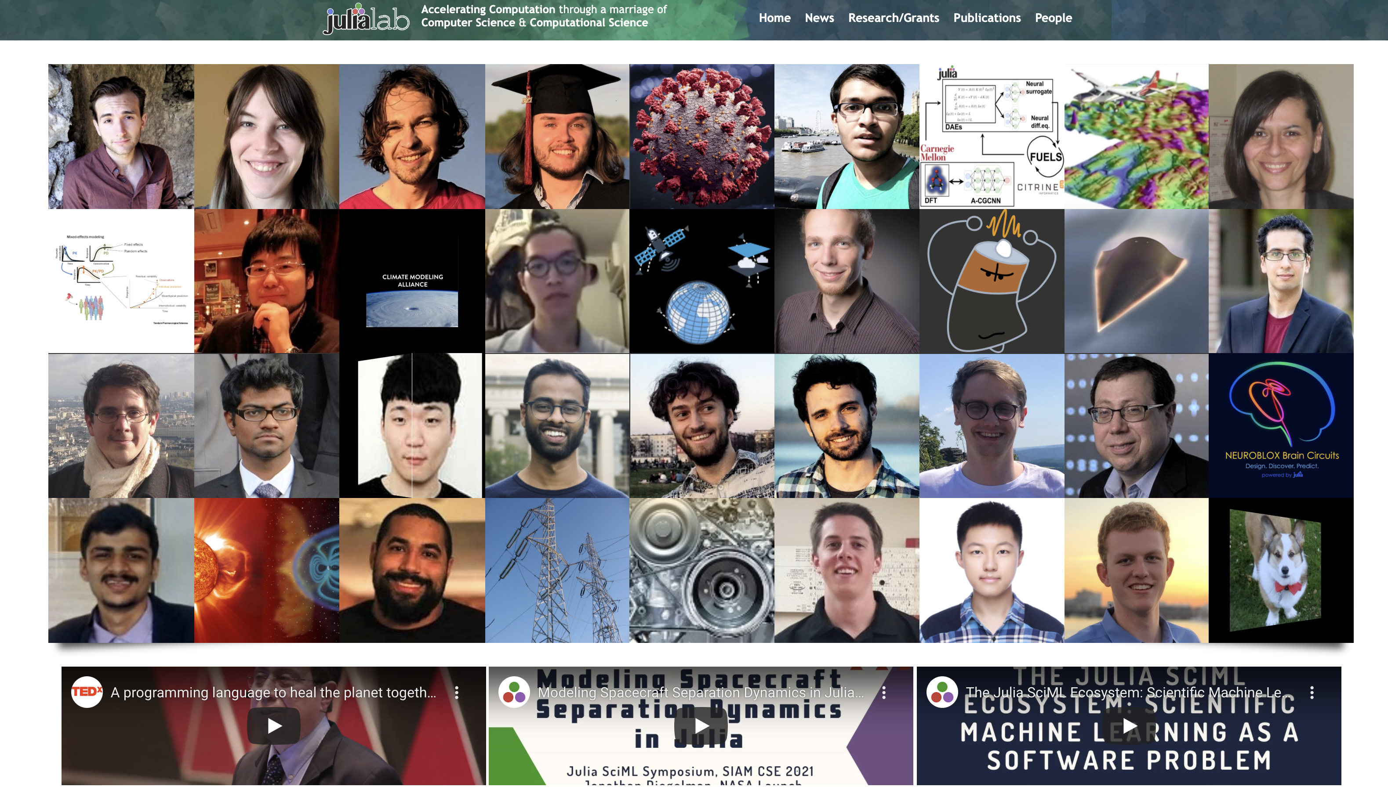
MIT Julialab: julia.mit.edu

Slide 3

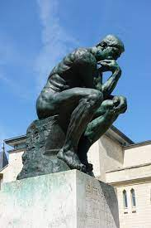
Audience Participation
Biggest Challenge in our field?

Slide 4
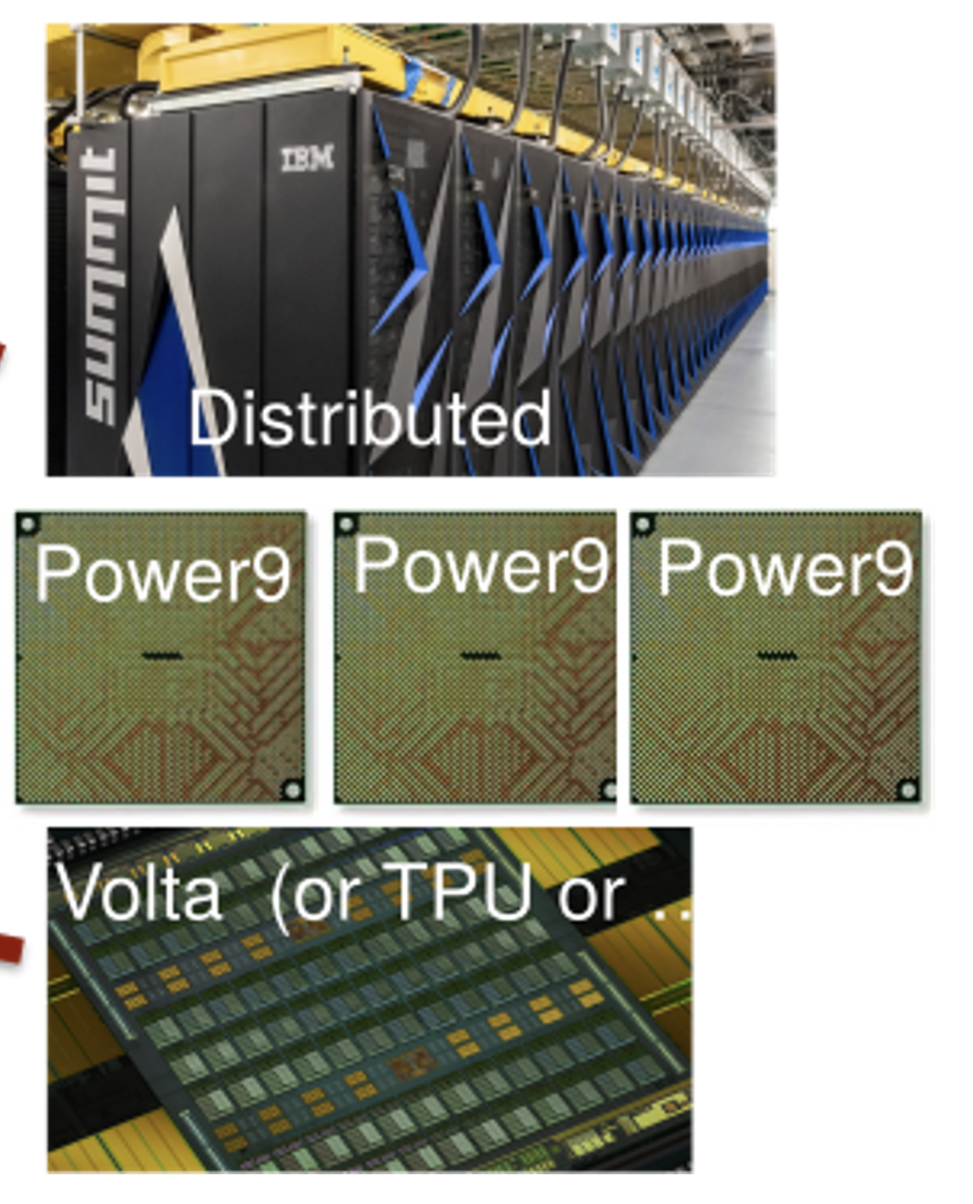
Heterogeneity Some may say …
but what is usually
meant by this?
Of course Performance!!!

Slide 5
Heterogeneity Some may say …
but should it be?

Slide 6
Heterogeneity Some may say …
How can we program these complex systems for performance?

Slide 7


Heterogeneity Some may say …
How can we program these complex systems for performance?
Optimizing solely for performance leads to decades of missed opportunities
NOTHING
IS MORE EXPENSIVE THAN A MISSED OPPORTUNITY
H. Jackson Brown, Jr

Slide 8
Heterogeneity Some may say …
How can we program these complex systems for performance?
If I could influence the field, I would remove performance as the sole metric of success.
NOTHING
IS MORE EXPENSIVE THAN A MISSED OPPORTUNITY
H. Jackson Brown, Jr

Slide 9
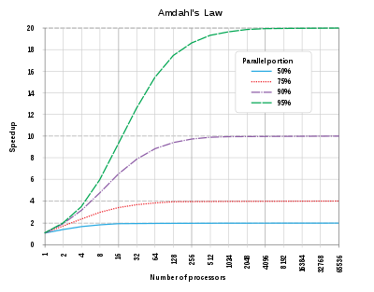

Heterogeneity Some may say …
How can we program these complex systems for performance?
If I could influence the field, I would remove performance as the sole metric of success.
Speedup curves only

Slide 10
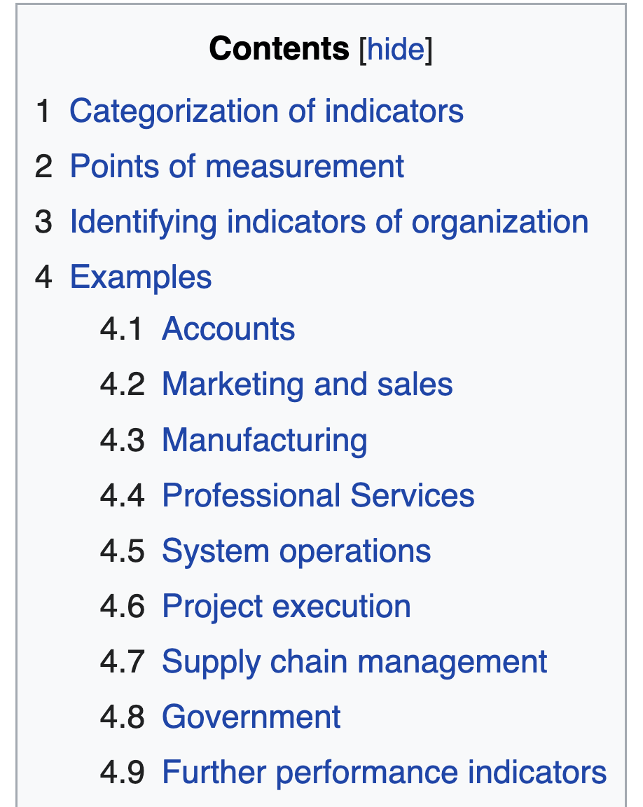
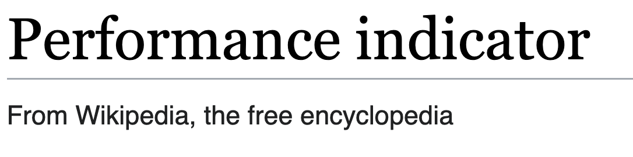
Heterogeneity Some may say …
How can we program these complex systems for performance?
I would replace (with discretion) with the size of the user or developer community. (Impact!)
Performance is but one component!

Slide 11
Audience Participation
Biggest Challenge in our field?

Slide 12


Time for a summary
Performance alone has lead to opportunity loss
performance / productivity / reusablility / community /…
What technically is desirable in the bedrock to achieve the impact we deserve?
More and more are getting the memo:
Especially the younger crowd

Slide 13
What about programming models?
Data parallel – often associated with GPU
Task parallel – often associated with Shared Mem
Message Passing – often associated with Distributed Mem

Slide 14
What about programming models?
Each has their own style
Difficult to composite due to different styles
Lots of inconsistencies
Fragmented communities?
Difficult to reuse and extend existing work
Data parallel
Task parallel
Message Passing

Slide 15
Audience Participation
Biggest Challenge in our field?

Slide 16
Audience Participation
Biggest Challenge in our field?
Language!

Slide 17
productivity
composability
maintainability
performance
community
innovation
Language!

Slide 18
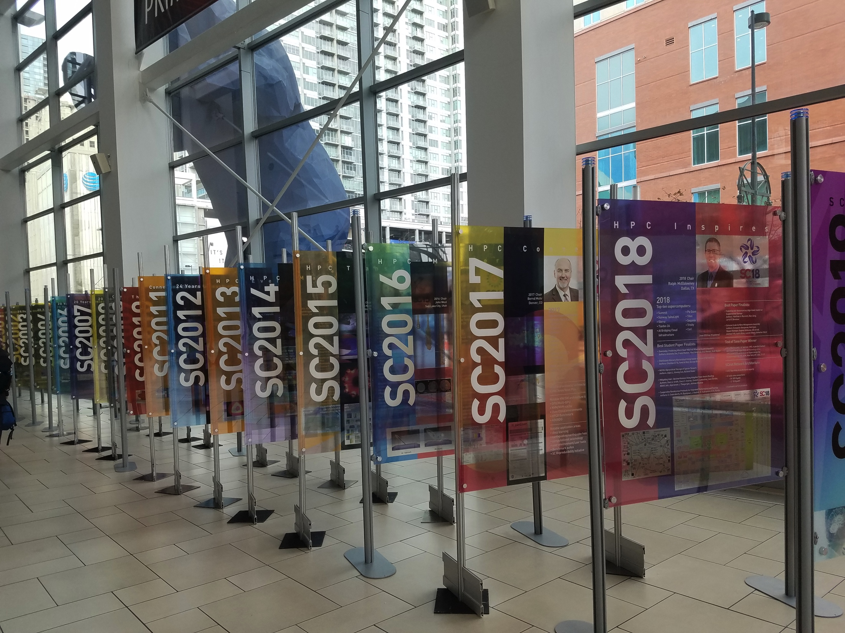
Something seems to have gone wrong!
1988
Programming Languages (x2005)
2010
2019
The dark decade

Slide 19
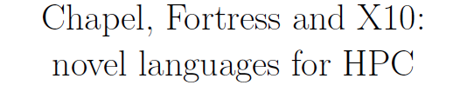
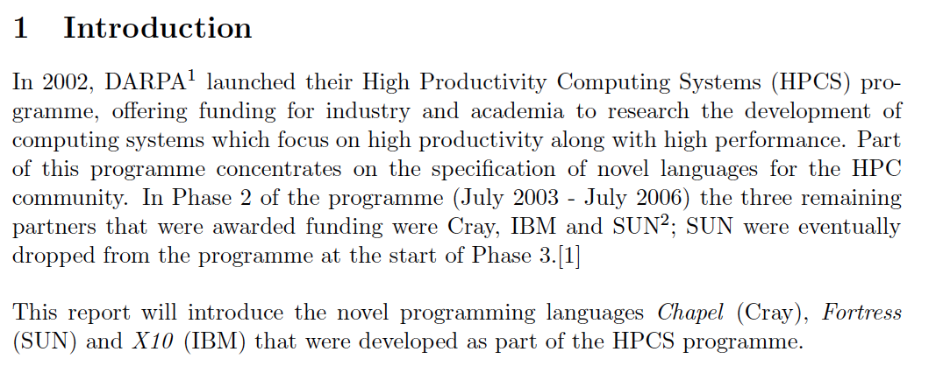
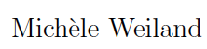
What did we miss 20 years ago?

Slide 20
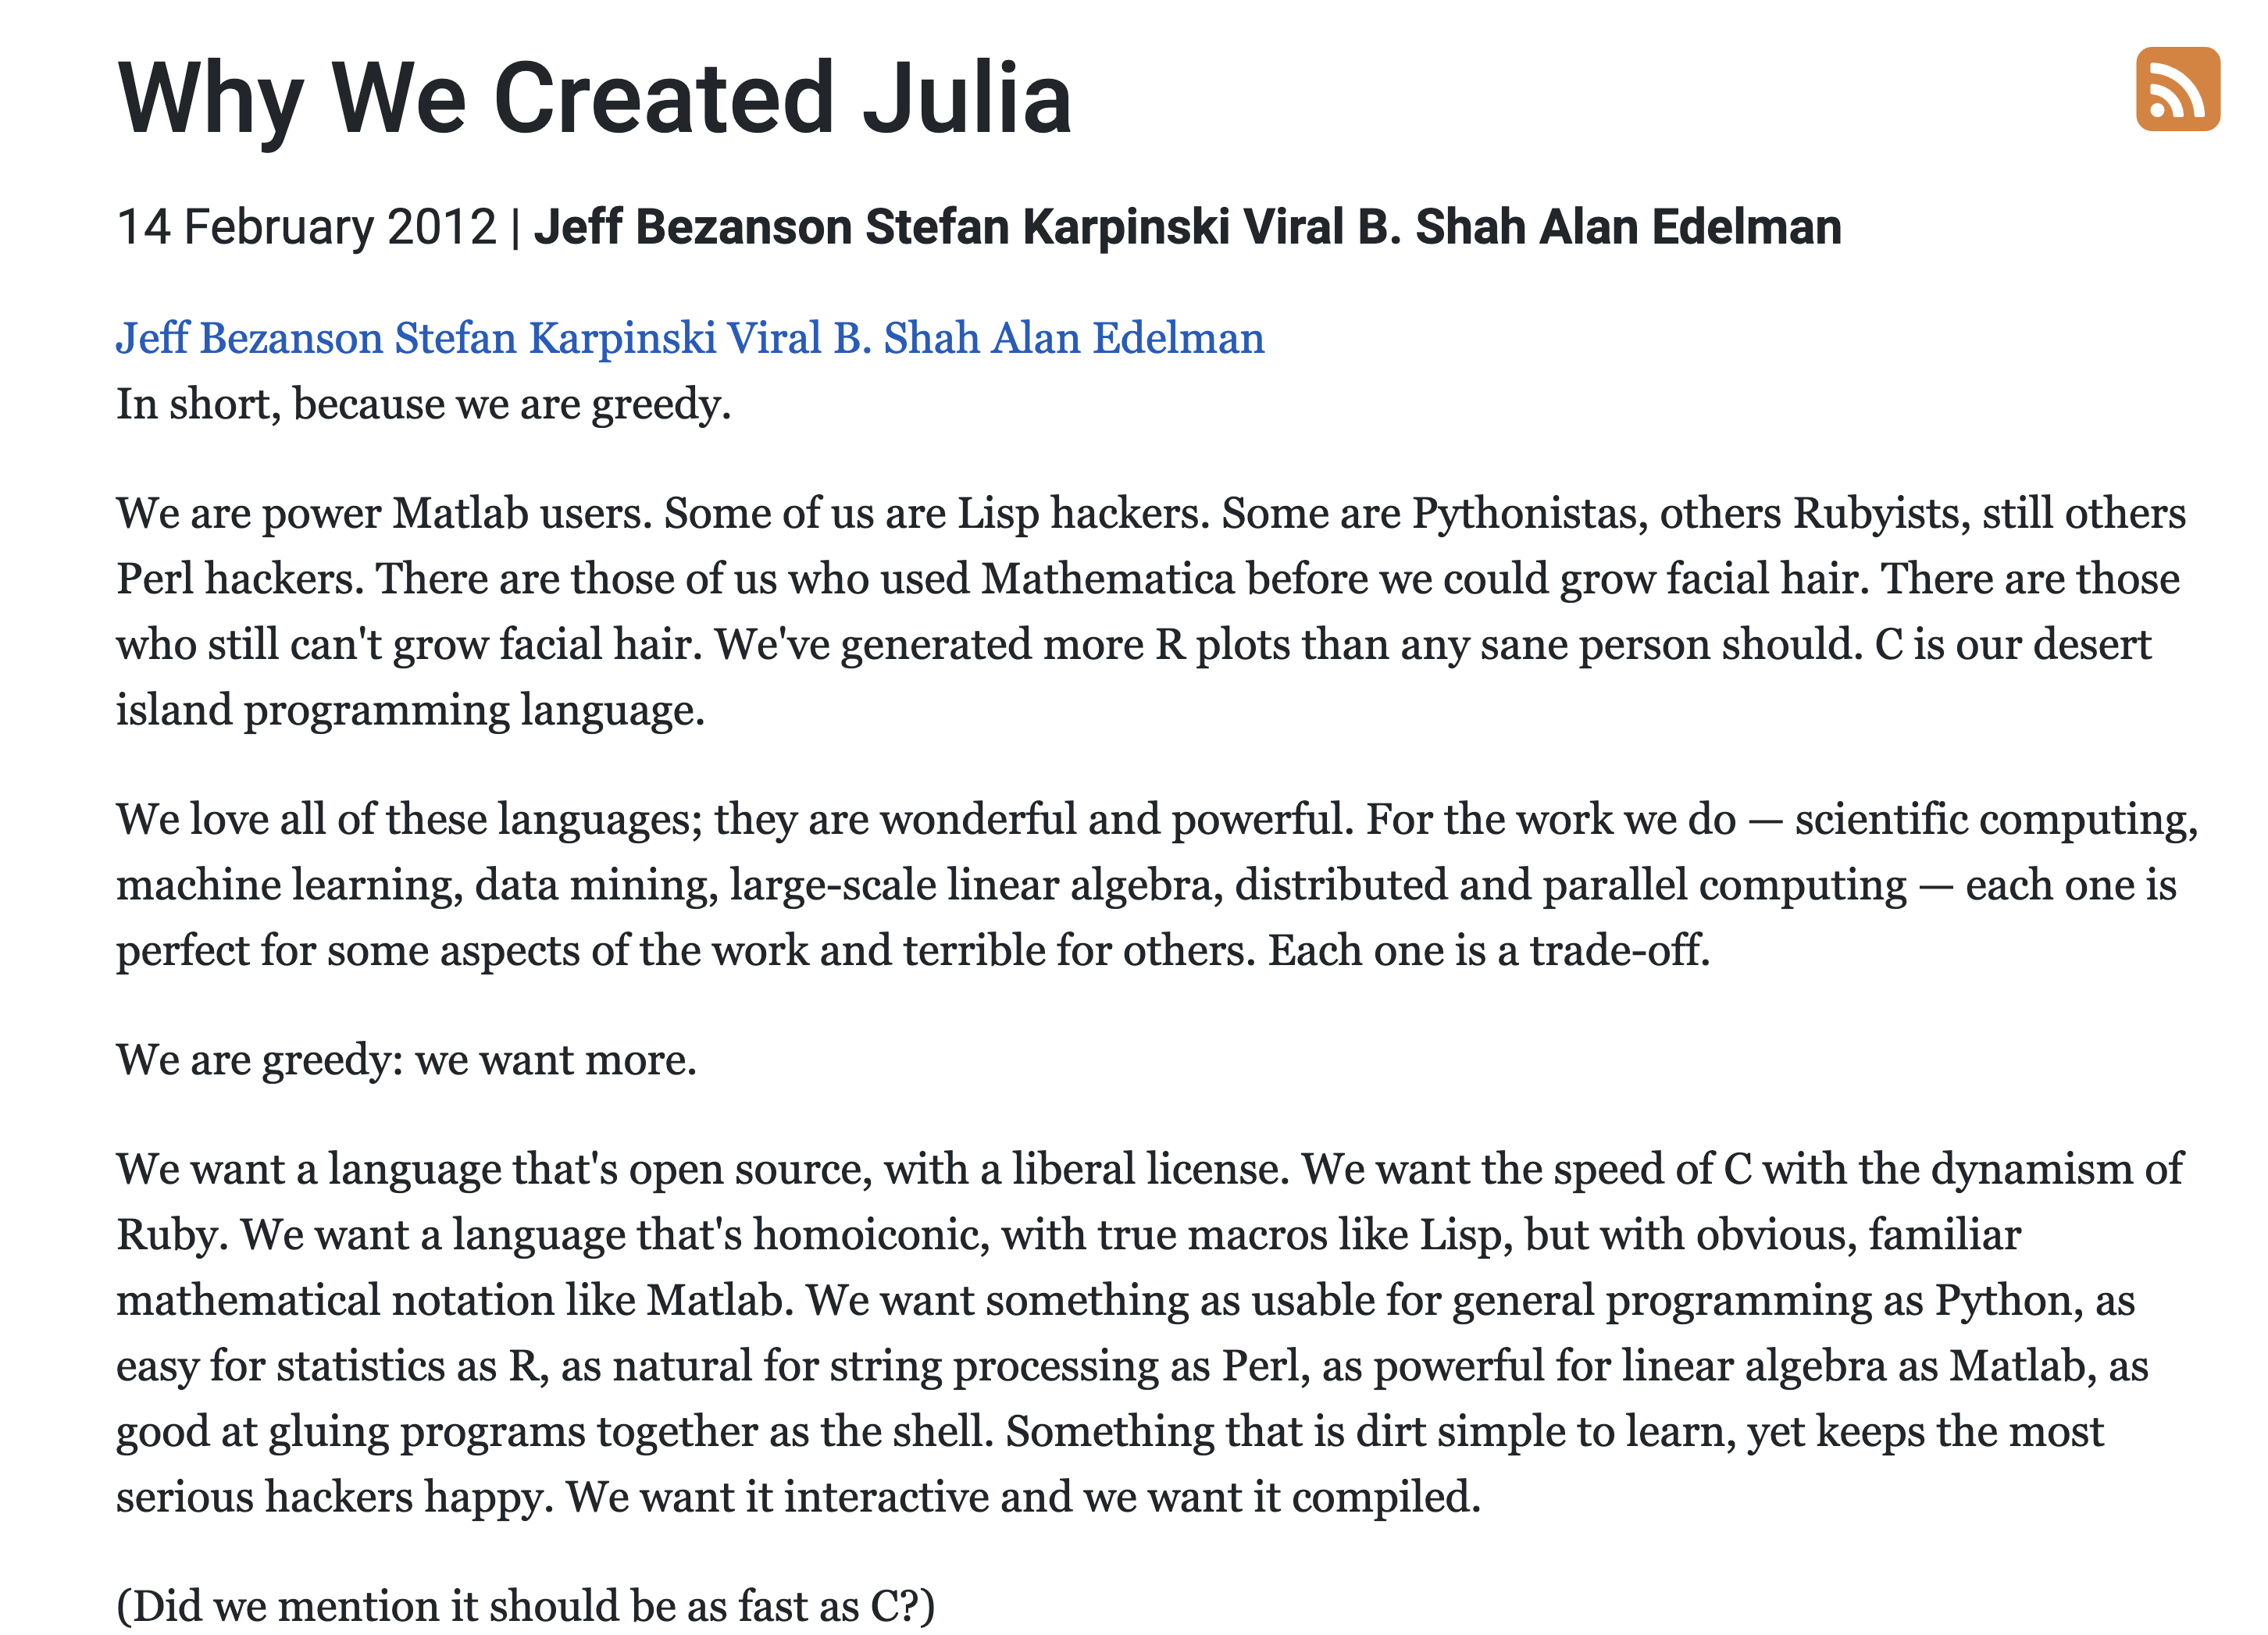
10 years ago
To solve the parallel computing problem – and it wouldn’t be easy.
We’d need help from the community.

Slide 21
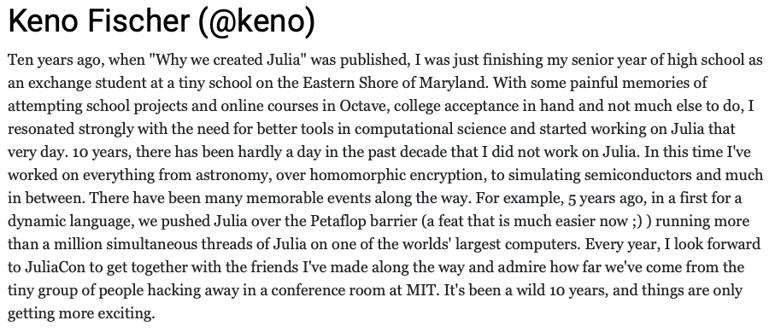
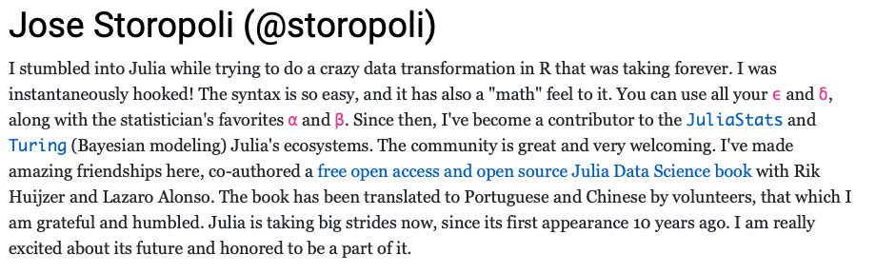
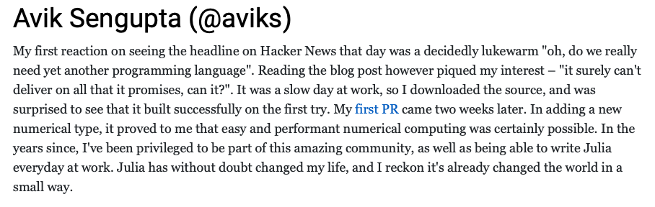
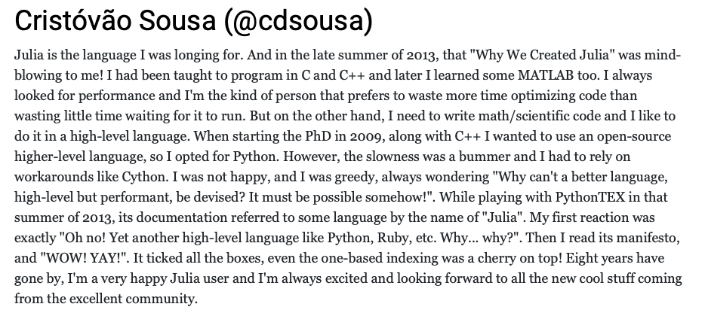
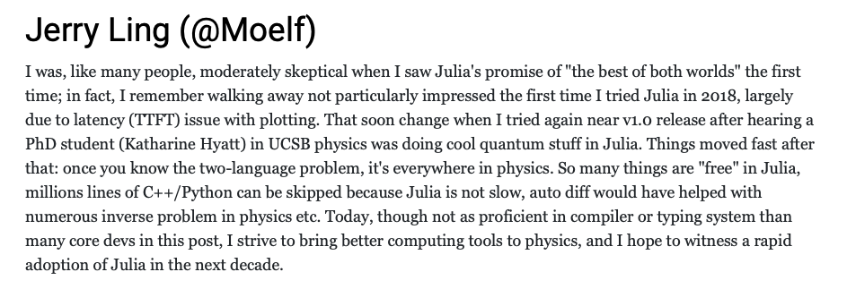
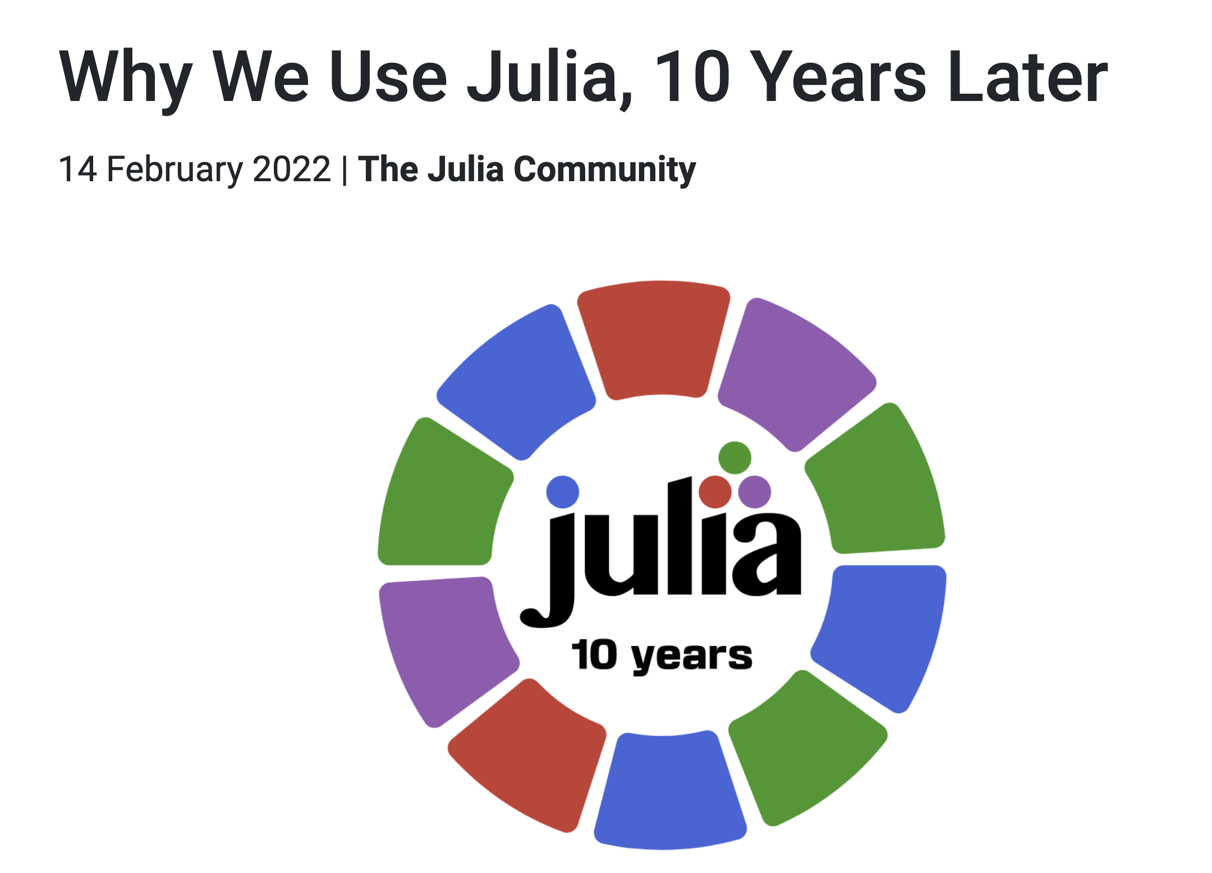
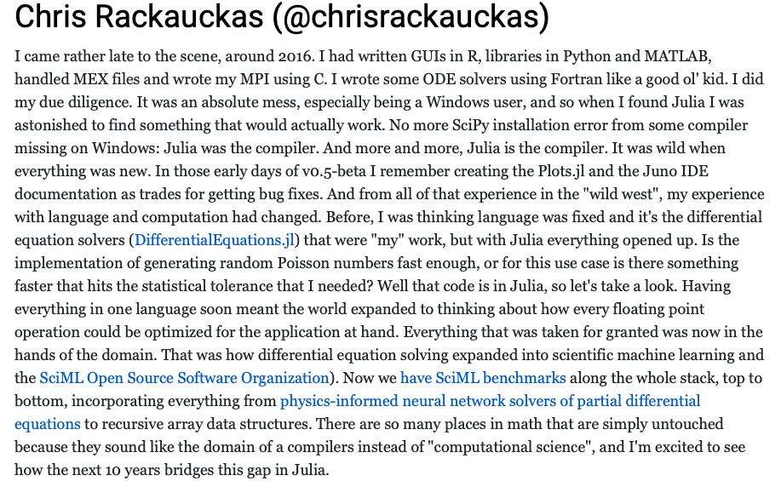
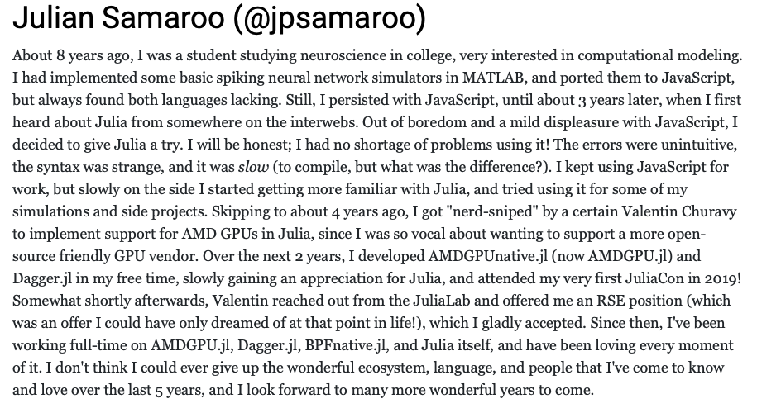
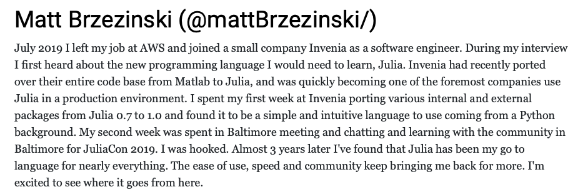
Today
To solve the parallel computing problem – and it wouldn’t be easy.
We’d need help from the community.

Slide 22
What did we miss 20 years ago?
A multidisciplinary user base for high productivity & high performance

Slide 23
What did we miss 20 years ago?
A multidisciplinary user base for high productivity & high performance
multiple dispatch
static + dynamic
type specialization
…

Slide 24
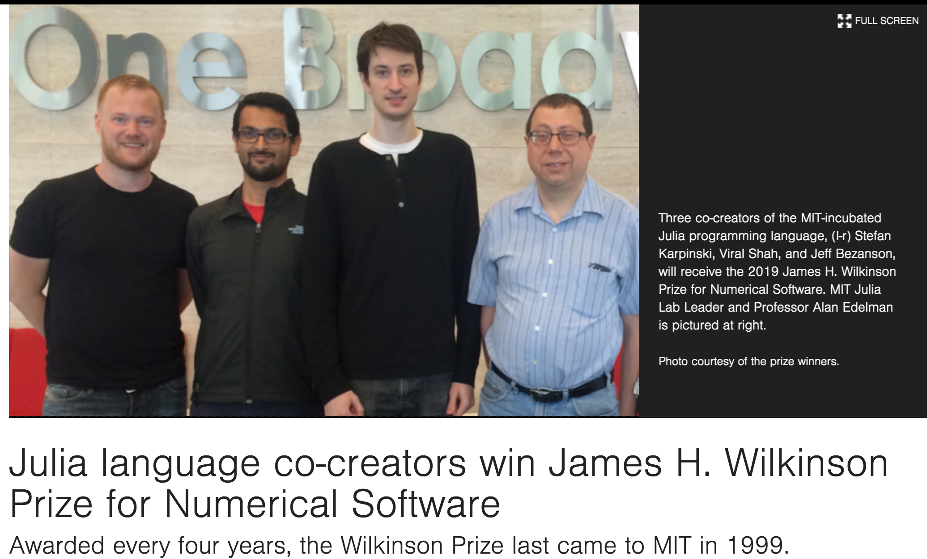
What did we miss 20 years ago?
A multidisciplinary user base for high productivity & high performance
multiple dispatch
static + dynamic
type specialization
…
“Patience is a virtue.”
We knew the right user base starts serial and takes over 10 years to mature.

Slide 25
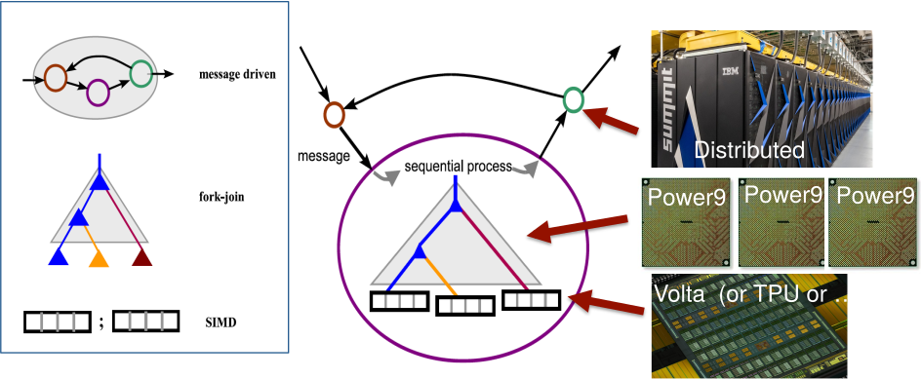
Back to Heterogeneity: Towards Higher Level Abstractions

Slide 26
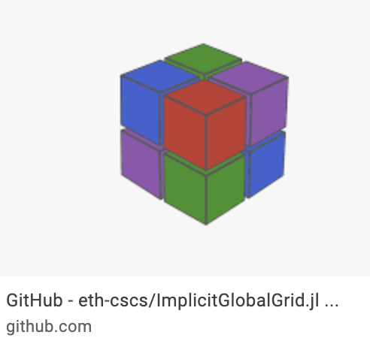


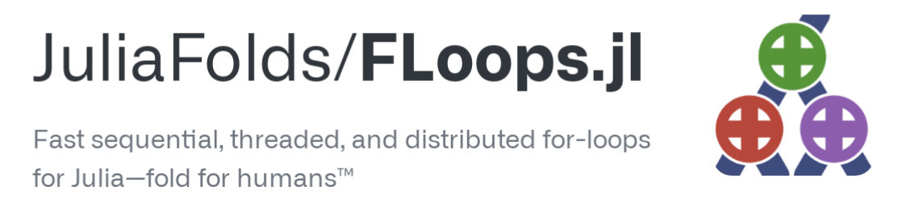

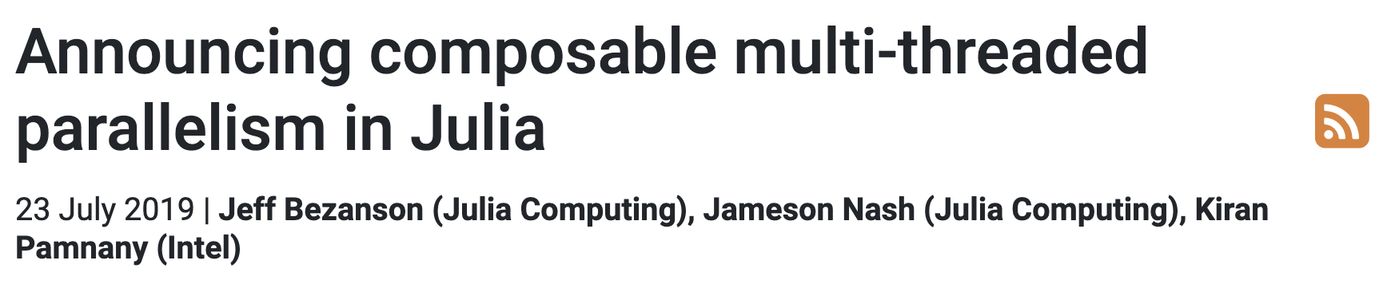
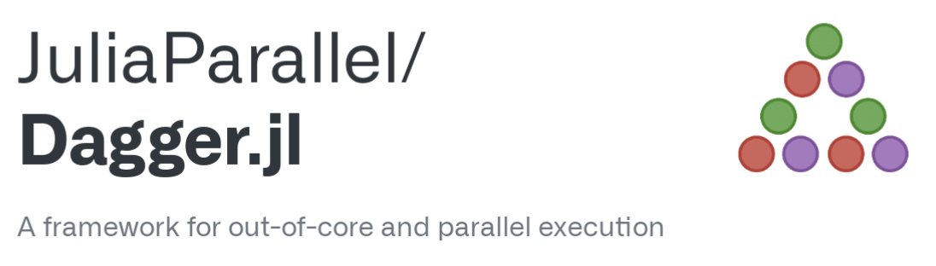

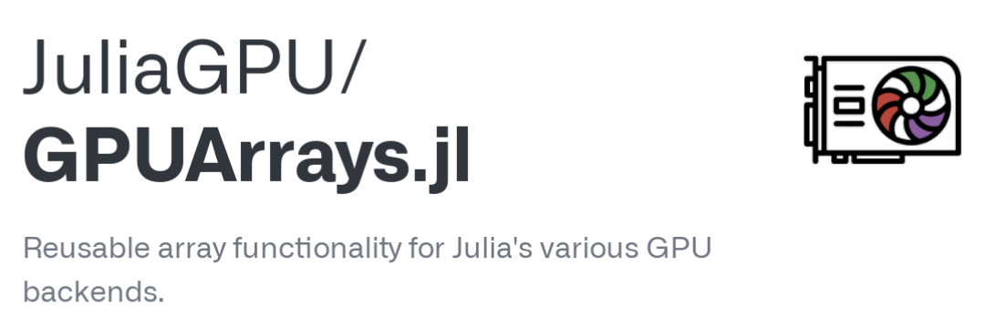
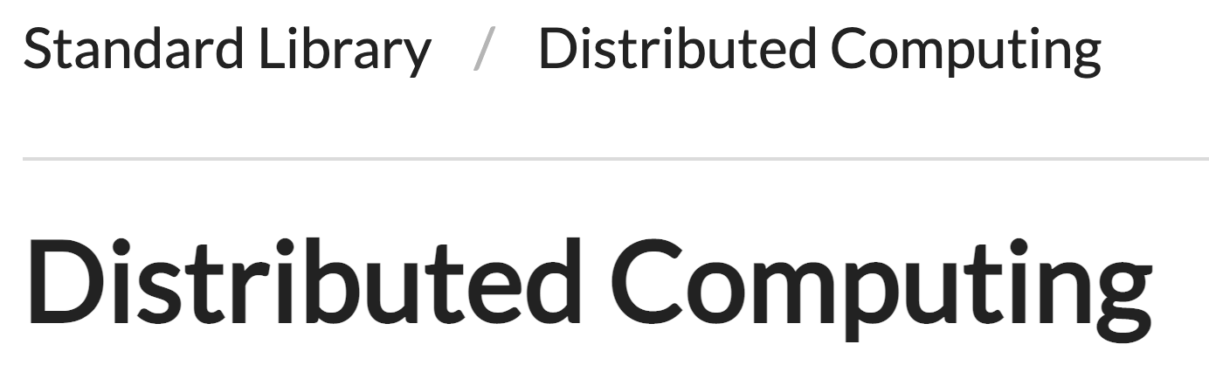
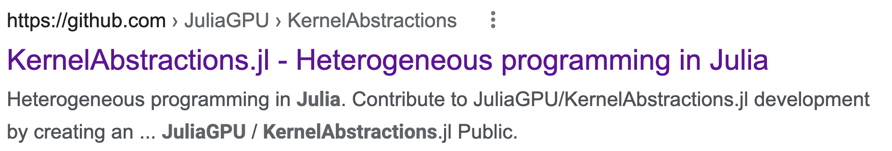
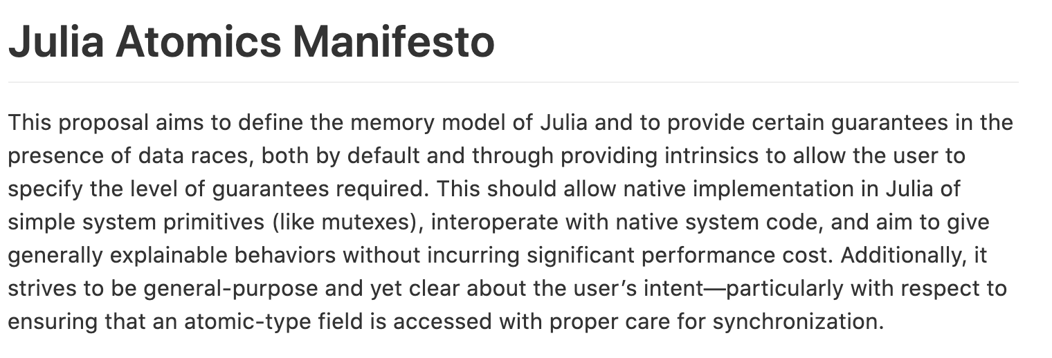
Julia HPC
Accelerators
Shared Mem
Distributed
AMDGPU.jl
CUDA.jl
OneAPI.jl

Slide 27
Julia HPC
Phase 1: Building up these tools
Phase 2: Letting these tools break out from these separate categories
Accelerators
Shared Mem
Distributed
AMDGPU.jl
CUDA.jl
OneAPI.jl

Slide 28
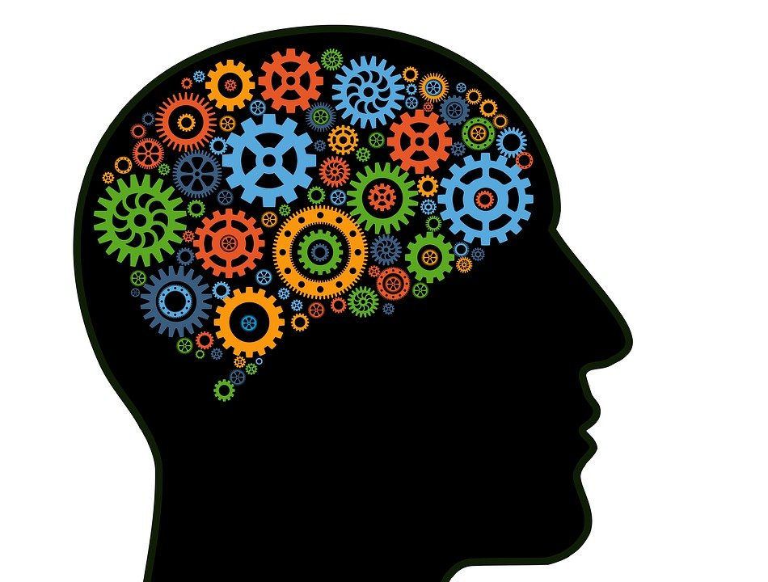
Julia HPC
Shared
Acc
Dist
Phase 1: Building up these tools
Phase 2: Letting these tools break out from these separate categories
Phase 3: Higher level abstractions
Acc
Dist
Shared
Accelerators
Shared Mem
Distributed
AMDGPU.jl
CUDA.jl
OneAPI.jl

Slide 29

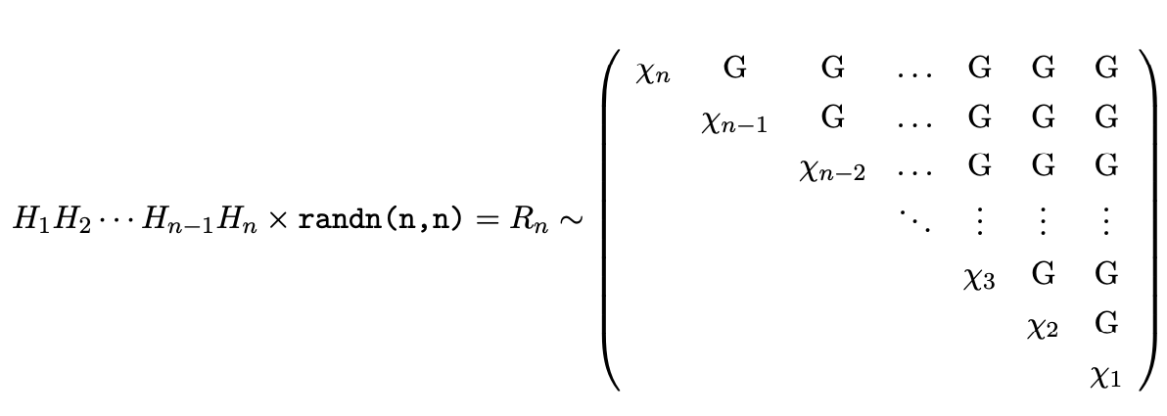
Case study: Histogram diag(qr(randn(n,n)) can’t help myself, I randomized linear algebra
H: Householder reflector
G: standard normal

Slide 30
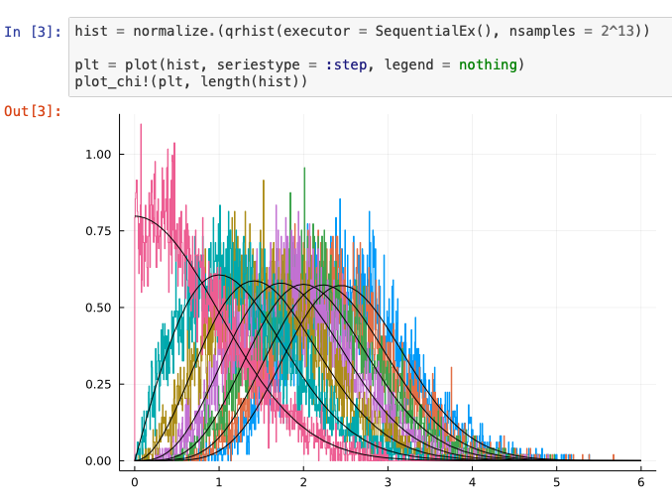
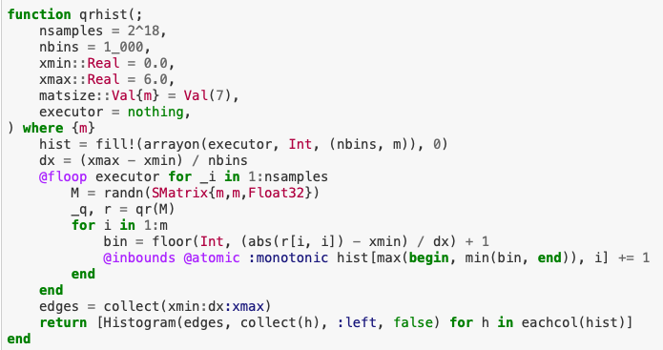
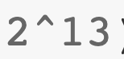
Write Once, Execute Anywhere!
Execution on a single CPU

Slide 31
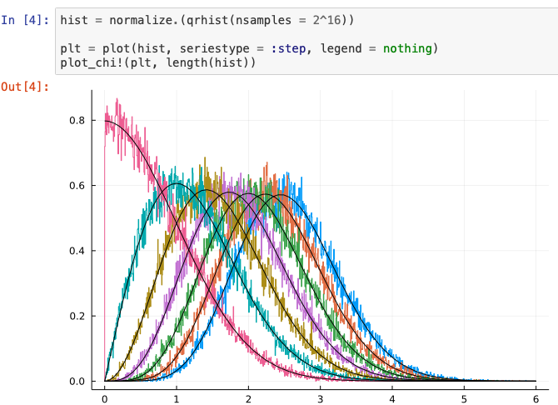

Write Once, Execute Anywhere!
Execution on multiple CPUs

Slide 32
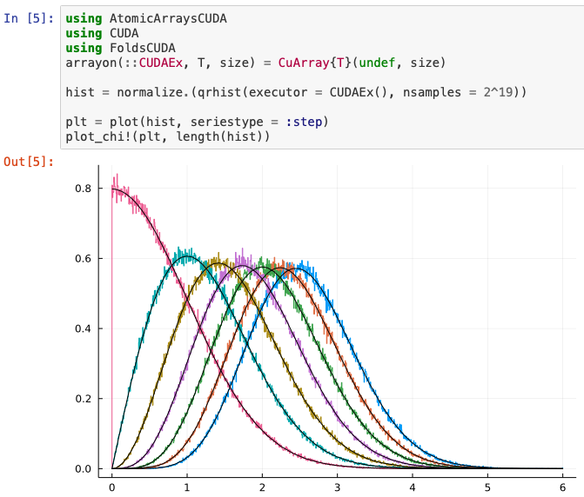
Write Once, Execute Anywhere!
Execution on GPU

Slide 33
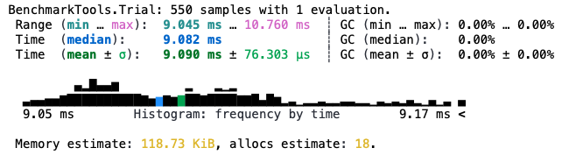
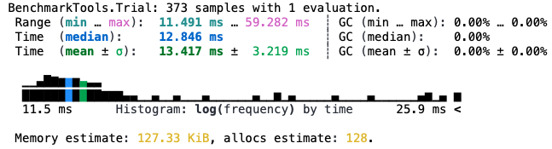
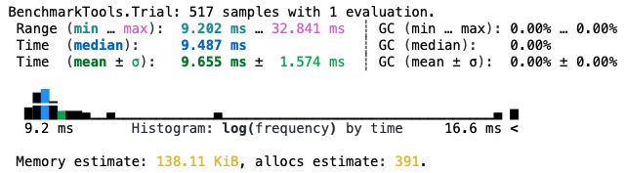
No sacrifice in Performance!
Execution on a single CPU
Execution on multiple CPUs
Execution on GPU

Slide 34
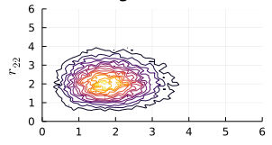
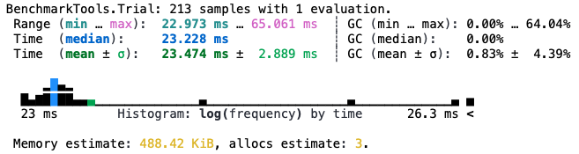
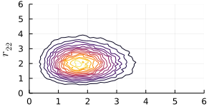
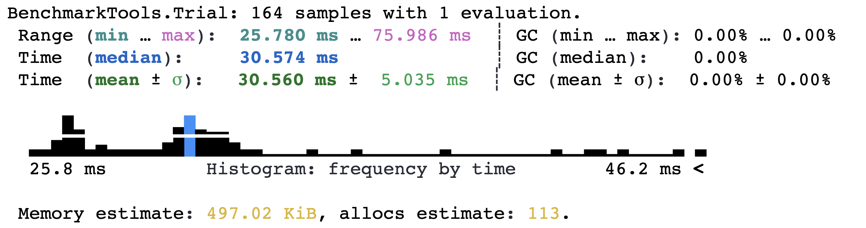
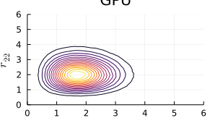
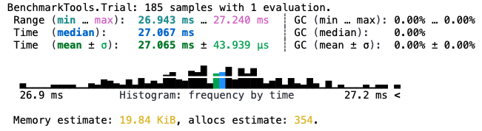
Even more prominent in 2D!
Execution on a single CPU
Execution on multiple CPUs
Execution on GPU

Slide 35
Productivity: Focus not on speedup but what can be accomplished / unit time

Slide 36
Showing Impact of Language
Case Study: A Random matrix histogram
No extra hoops to jump through for parallelism and GPU acceleration (no CUDA, no MPI,…)
distribution of diagonals of qr(randn(n,n))

Slide 37
Showing Impact of Language
Case Study: A Random matrix histogram
No extra hoops to jump through for parallelism and GPU acceleration (no CUDA, no MPI,…)
distribution of diagonals of qr(randn(n,n))
Demo: Diffusion
No Reinventing the Wheel – Build upon solid foundation
You have a C/MPI or Fortran/MPI Code? No need to rewrite
You need a ghost/halo code? No need to write
Can easily compose parallel modes
Message Passing and Task Parallelism

Slide 38
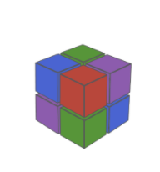
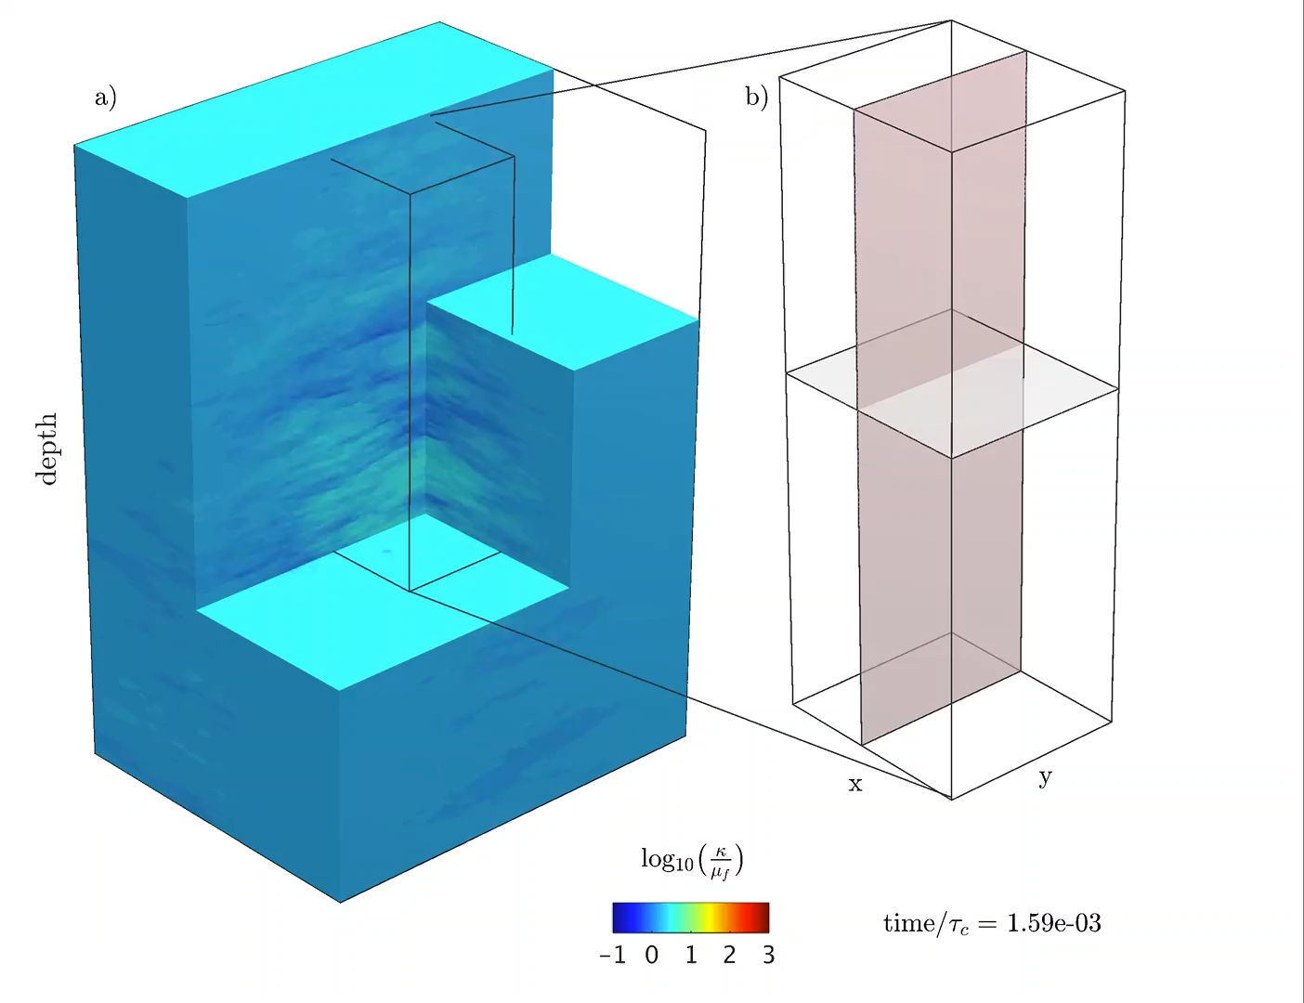
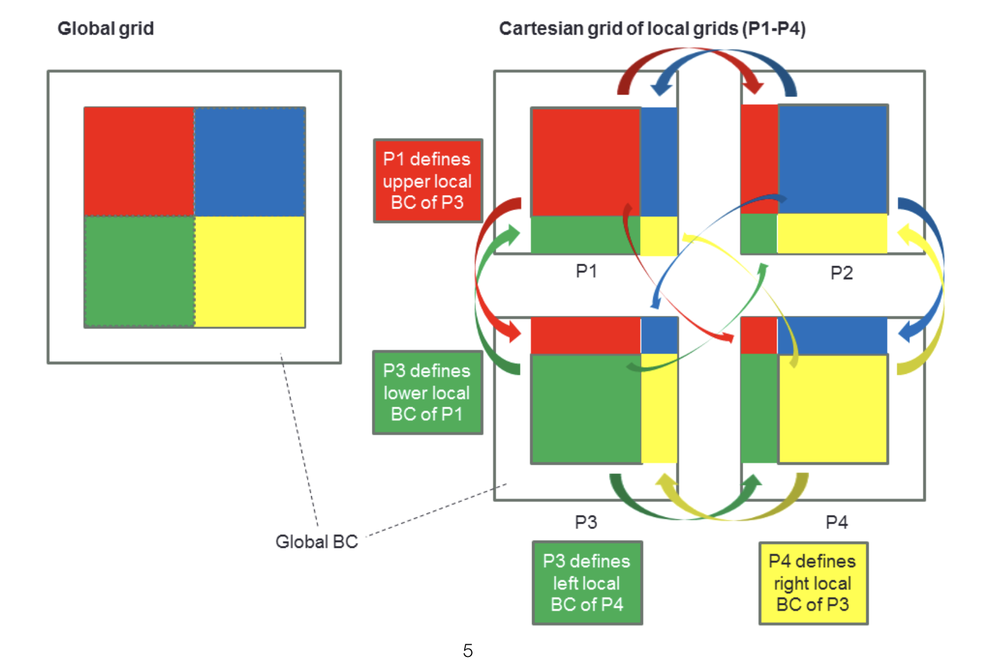

ImplicitGlobalGrid
Samuel Omlin & Ludovic Räss Swiss Computing Center
The most common HPC request: stencils & halo/ghost cells
Made nearly trivial!
Hide communication:
Compute boundary region and interior points on two different streams.
As soon as boundary region has finished, start halo update

Slide 39



Reported Results (ImplicitGlobalGrid.jl github)

Slide 40
Demos: Take home message
You have a C/MPI or Fortran/MPI? No need to rewrite!
You need a ghost / halo code? No need to rewrite!
You want to compose different parallel modes? Easy!
No re-inventing the wheel – Build upon solid foundations

Slide 41
productivity
composability
maintainability
performance
community
innovation
Solving Big Challenges in our times

Slide 42


“DFTK.jl”

Slide 43








Computing derivatives: Enzyme [MC20]
Enzyme performs automatic differentiation (AD) within the compiler.
CPU
LLVM
Enzyme
LLVM
GPU
Enzyme differentiates through MPI.
[MC20] Moses, Churavy. Instead of Rewriting Foreign Code for Machine Learning, Automatically Synthesize Fast Gradients. NeurIPS, 2020.

Slide 44





MIT News: New climate model to be built from the ground up
December 12, 2018
To take advantage of new computer architectures, languages, and machine learning techniques, the team has partnered with Alan Edelman‘s group in CSAIL at MIT, who will help write the new generation climate model in the Julia computing language developed by the group. This will enable the MIT team to target GPUs, CPUs, and evolving computer architectures within one code base.
Tapio Schneider Chris Hill Raffaele Ferrari John Marshall

Slide 45


JuliaSim Simulating Reality

Slide 46




Code is the “New” Math
You don’t “code” the “math,” “code” is the “math”

Slide 47
Conclusion
Biggest Challenge in our field?
Making Parallel Computing Easier

Slide 48
Conclusion
Biggest Challenge in our field?
Making Parallel Computing Easier
Join the great community:

